Slide 1

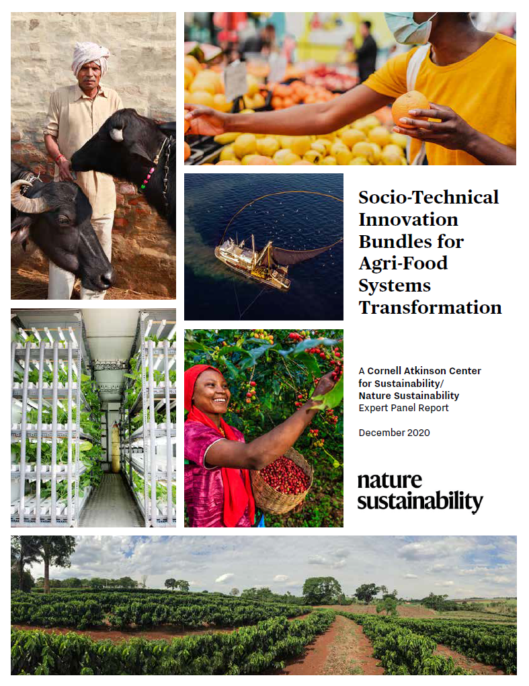
Christopher B. Barrett
Cornell University
International Food Policy Research Institute
virtual seminar
March 19, 2021

Slide 2























Expert panel
Cornell Atkinson – Nature Sustainability 2020 expert panel on “Innovations to Build Sustainable, Equitable, Inclusive Food Value Chains” comprised a diverse group of 23 experts from across disciplines, regions, organizations, etc. Met Dec 2019-Nov 2020. Added 10 additional co-authors, report issued Dec. 2020.
Based on the”, released Dec. 2020.

Slide 3
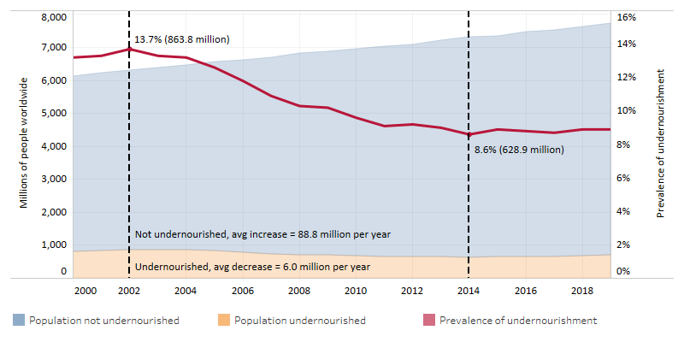
Core motivation
AFS innovations have enabled huge advances in human well-being.
But also adverse, unsustainable spillover effects on climate, natural environment, public health/nutrition, social justice.
Must update objectives, accelerate and reorient innovations.

Slide 4
Key conclusions
The expert panel reached several key conclusions:
1. B/c AFS consist of complex webs of actors and processes, must keep four key features firmly in mind:
Human agency by billions actors is key .. mechanism design
Heterogeneity precludes one-size-fits-all solutions
Spillover effects pervasive and demand portfolio approaches
Science-based innovation needed in evolutionary systems

Slide 5
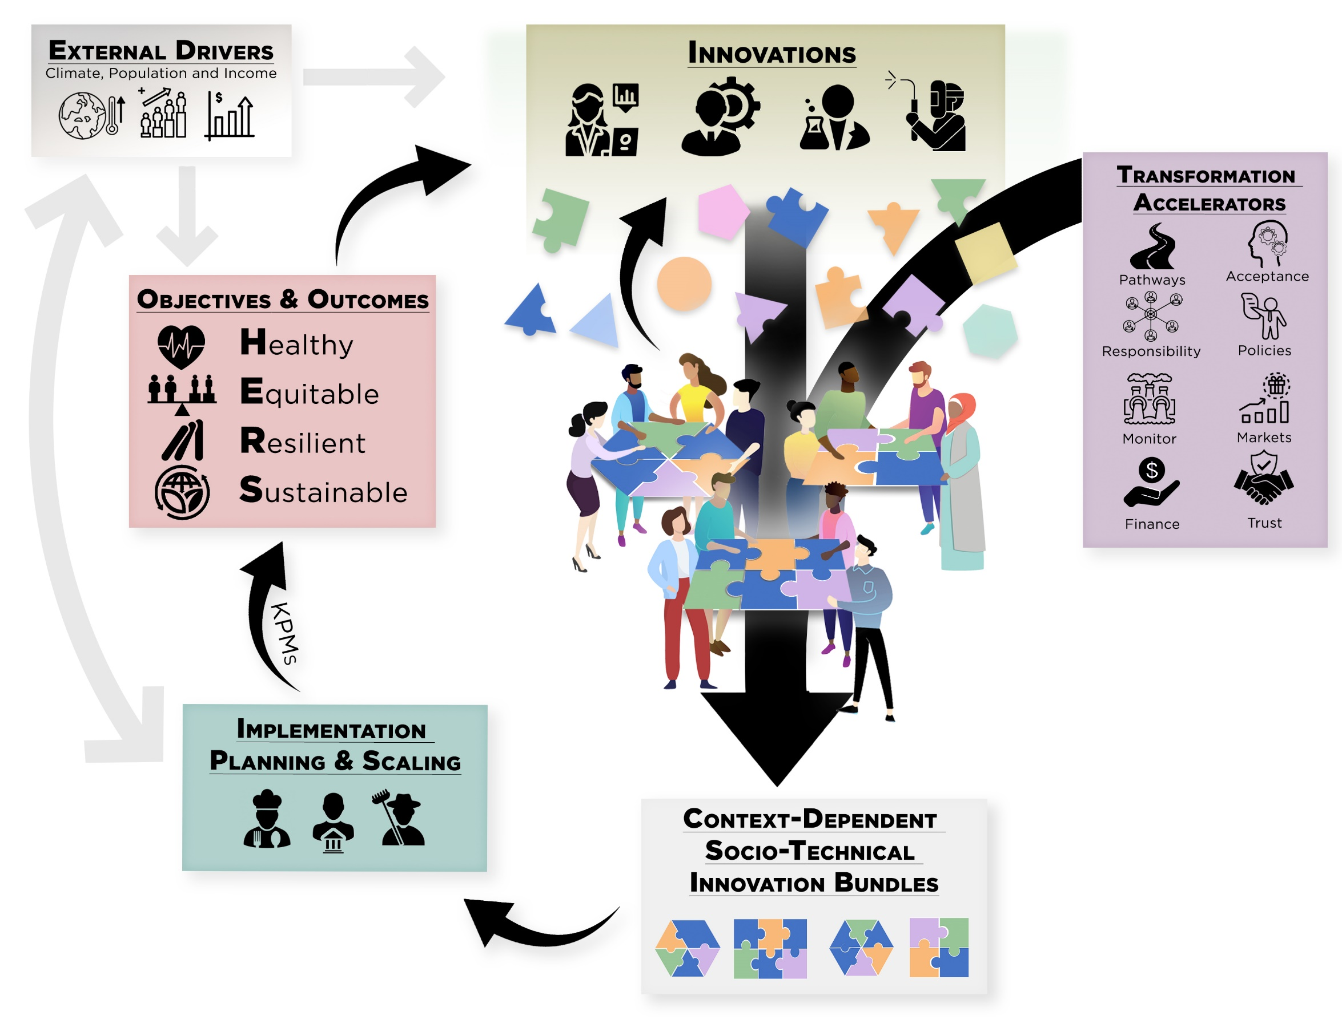
Key conclusions
2. A shared vision of HERS agri-food systems.
Must embrace multiple objectives simultaneously:

Slide 6

Key conclusions
3. Must design for future states, not today’s. Looking 25-50 yrs ahead (past 2030 SDGs, to scaled impact of emergent and ideated innovations), 3 major changes loom:
Climate change
Population shifts – urbanization, aging
Income growth
One key implication:
Pay FAR more attention to Africa … will account for >50% of global food demand growth to 2100

Slide 7
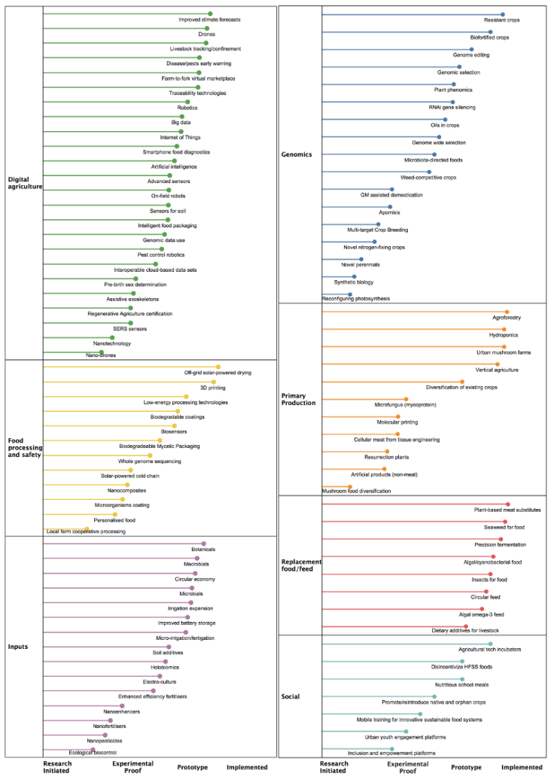
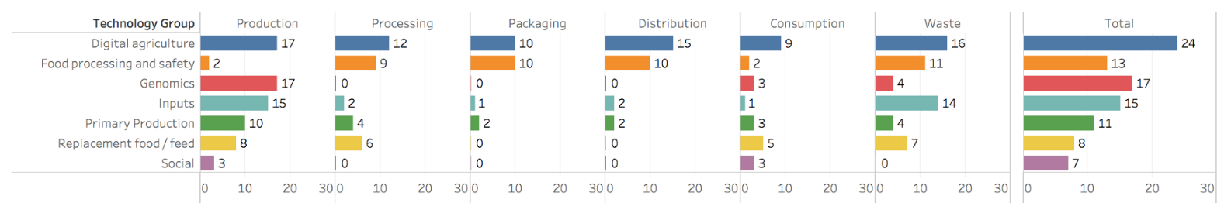
Report highlights
4. A profuse pipeline exists of promising (natural and social) science advances at various stages of deployment readiness. Span value chains and geographies.

Slide 8

Report highlights
Figure 1: The agri-food systems innovation cycle.
The agri-food systems innovation cycle

Slide 9
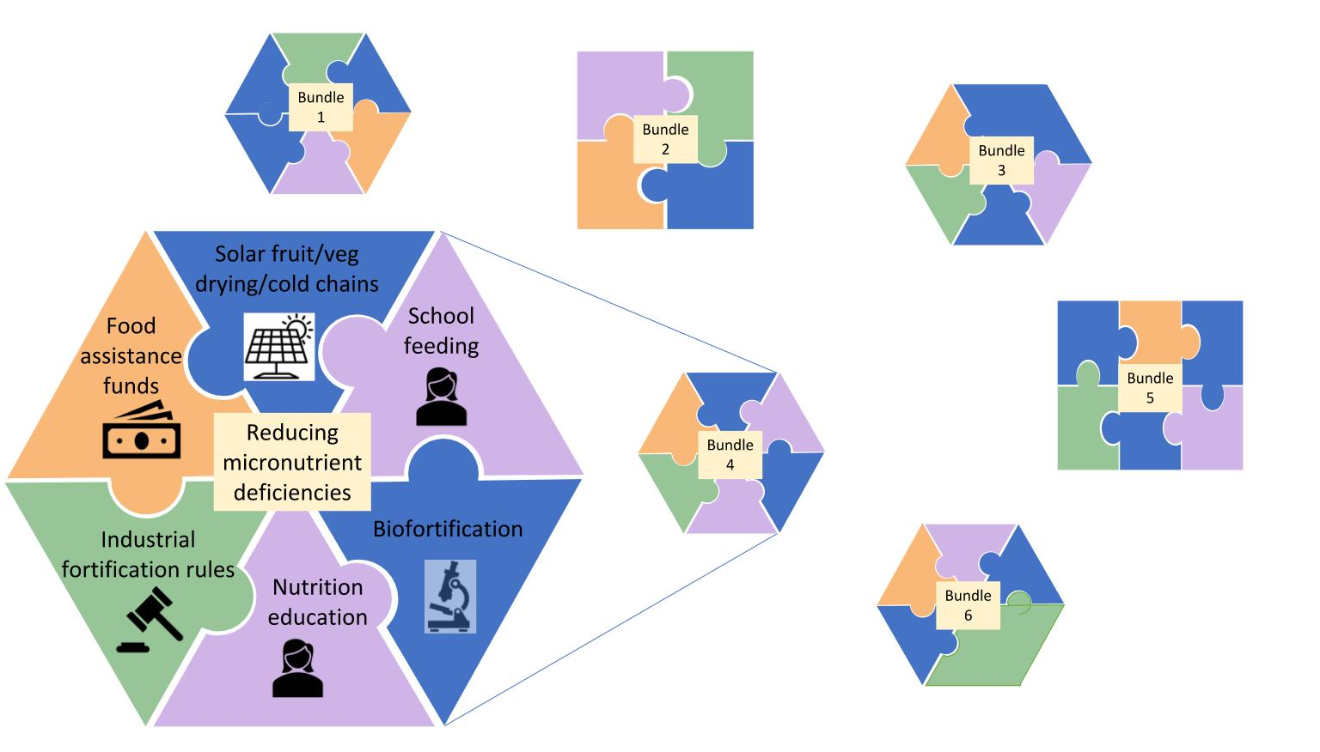
7 Essential Actions
Develop socio-technical innovation bundles.
No magic bullets exist. Need to bundle in order to:
  realize synergies needed to adapt/scale
  address political economy arising from spillovers
  meet heterogeneous needs

Slide 10

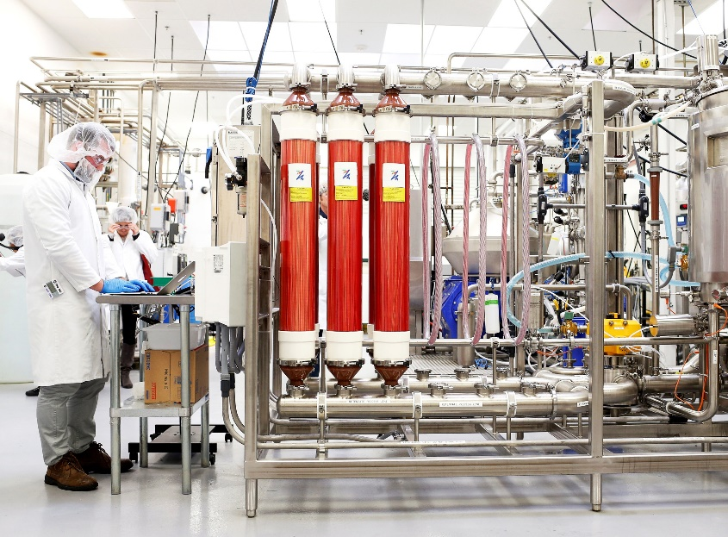
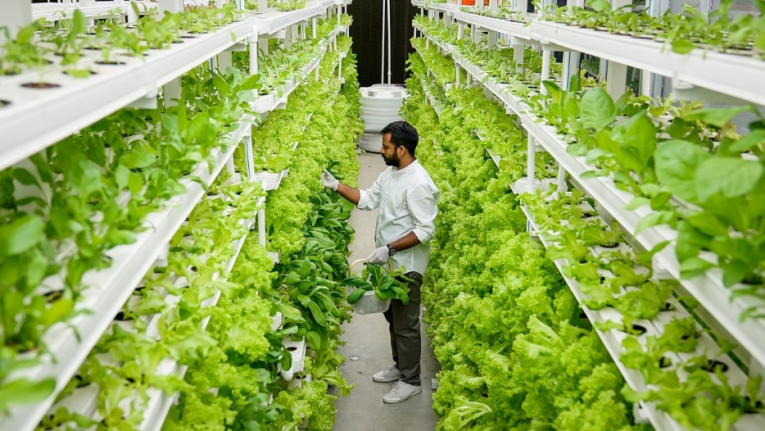
7 Essential Actions
2. Reduce the land and water footprint of food.
Decoupling food production from land increasingly culturally, economically, technologically feasible. Manage de-agrarianization’s creative destruction.
Photo: Beck Deifenbach/Reuters
Photo: Gerry Machen/Creative Commons
Photo: Betterindia.com

Slide 11
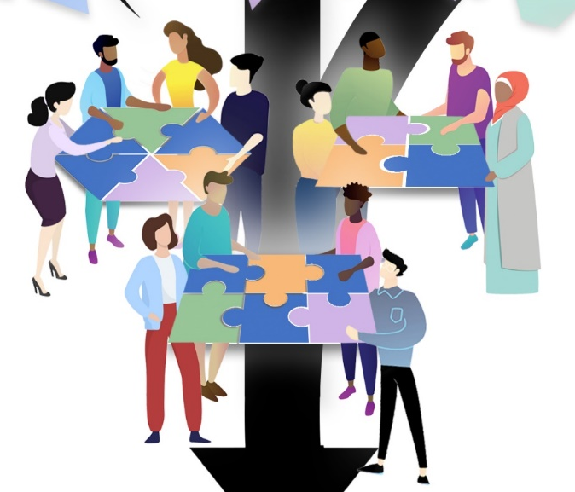
7 Essential Actions
3. Commit to co-creation with shared and verifiable responsibility. Agreed KPMs, safety nets, penalties can accelerate beneficial innovation and minimize adverse unintended consequences.

Slide 12
7 Essential Actions
4. Deconcentrate power. Reducing market and political power imbalances and broadening participation in innovation dialogues can accelerate innovation.

Slide 13
7 Essential Actions
5. Mainstream systemic risk management.
COVID-19 underscores the rising importance of effective systemic risk management. Need innovative risk reduction and risk transfer mechanisms.

Slide 14
7 Essential Actions
6. Develop novel financing mechanisms.
AFS innovations require $$$ (hundreds of billions annually).
How to mobilize private resources beyond public spending/philanthropy?

Slide 15
7 Essential Actions
7. Reconfigure public support for AFSs
Two key roles for gov’ts:
invest in essential public goods and services
facilitate dialogue to find cooperative solutions.
Much current government AFS spending is wasteful ($2bn/day!)
Redirect towards social protection programs, agri-food research, and physical and institutional infrastructure.
Foster civil society dialogues to identify and support contextually appropriate socio-technical bundles.

Slide 16
Thank you
Report and associated journal articles, videos, etc. available at https://blogs.cornell.edu/nature-sustainability/
Thank you for your time and interest!

